Slide 1
WELCOME TO THE FANTASY ADVENTURE!!!
A RPG TEXT GAME
ARE YOU READY FOR THE ADVENTURE?!?!

Slide 2
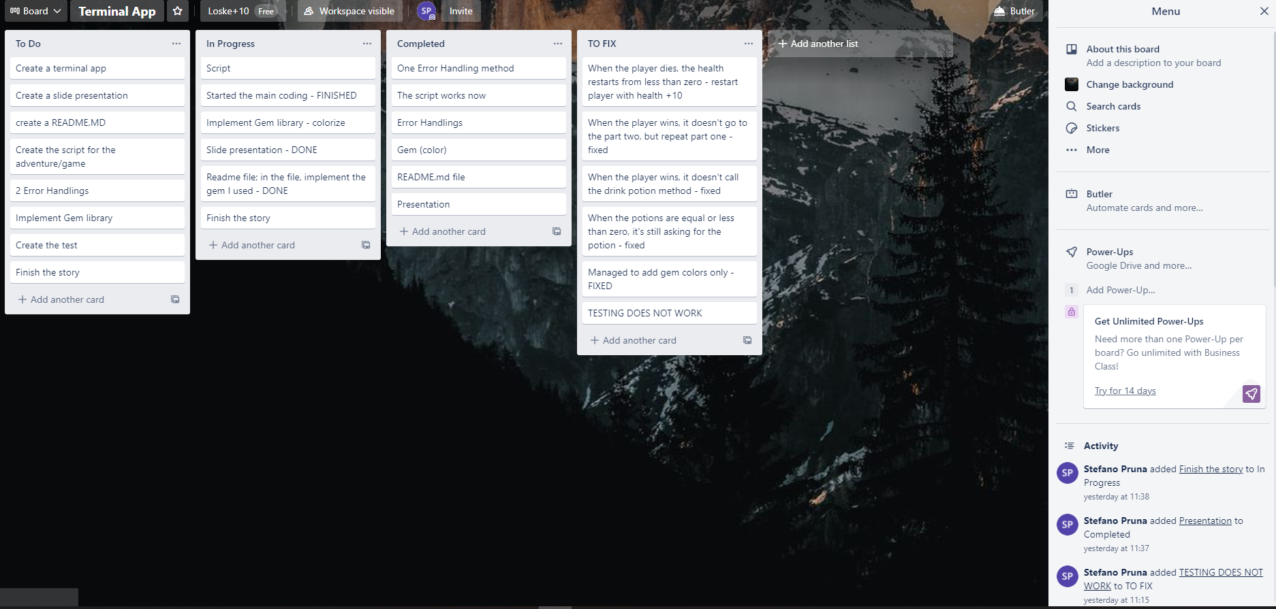
MY SCHEDULE IN TRELLO

Slide 3
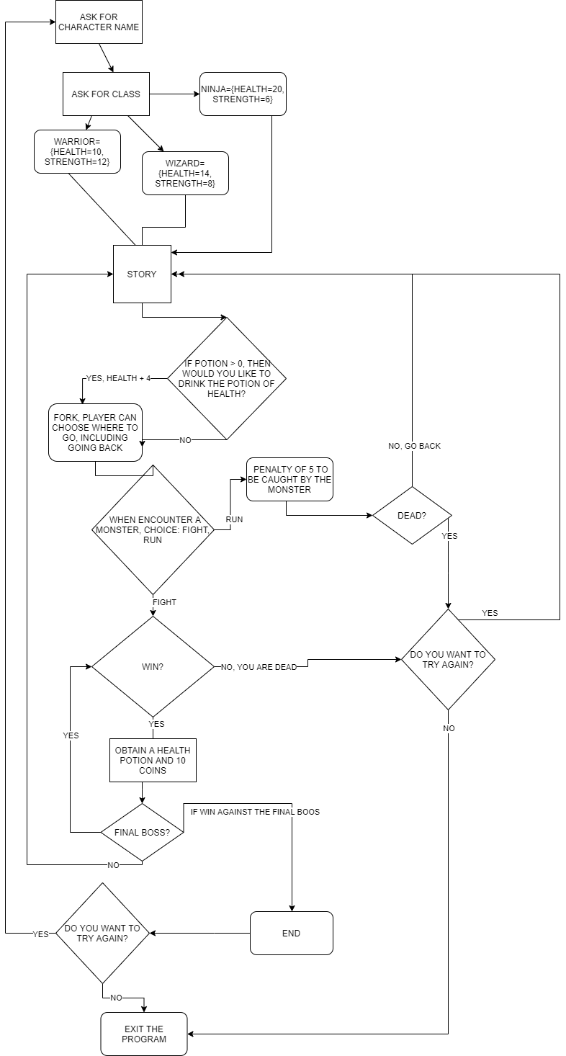

Slide 4
Dependencies:
THE PROGRAM DOES:
The program will request to interact with the user in order to go through the adventure, such as:
- Ruby Terminal
- Gem library colorize
- Run ruby adventureapp.rb

Slide 5
INSERT CHARACTER NAME
CHOOSE THE CLASS OF THE PLAYER
(Not the class in oop, just the adventure class, like Mage, Fighter...)

Slide 6
DURING THE ADVENTURE, THE PROGRAM ASKS:
What direction to go;
Whether to fight or run;
The program will output all the player's choices and update the character's inventory and health

Slide 7
PROS’ AND CONS’
CONS’
PROS’
It’s a pity that it’s only a text without graphic interface
I have understood the power of OOP now! I could have used different files for each different classes, like for the player, monster, inventory rather than use only one big long file
It can be done more efficiently, it’s not clean code
I really enjoyed doing the adventure!

Slide 8
WILL I IMPLEMENT GRAPHIC INTERFACE IN THE FUTURE?
OR MAYBE I WILL JUST USE THE STORY TO MAKE A GAME

